Slide 1

ACP’s 80+ FORTUNE 500 PARTNER COMPANIES

Slide 2
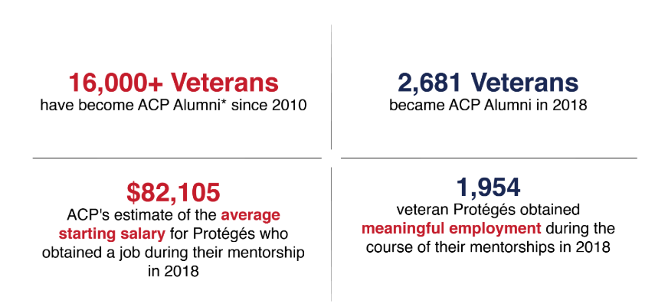
MENTORING PROGRAM SUCCESS

Slide 3
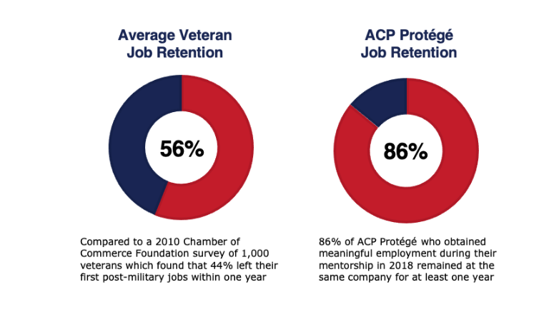
PROTÉGÉ RETENTION

Slide 4
Program Eligibility Requirements
ACP welcomes applications from service members, veterans and spouses who meet the following eligibility criteria:
Active duty service members (including members of the Reserve and National Guard).
Veterans of the armed forces that have served at least 180 days on active duty orders since September 11, 2001.
Surviving spouses and spouses of severely wounded post-9/11 veterans.
Service members who served less than 180 days of active duty since 9/11, but who were injured while serving or training.
The spouses of active duty service members

Slide 5
APPLY NOW
acp-usa.org

Slide 6

HOW TO APPLY

Slide 7
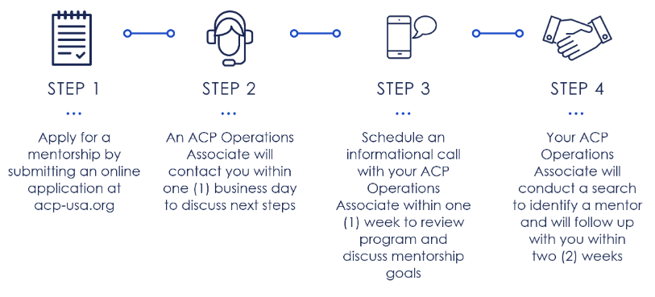
TIMELINE OF NEXT STEPS

Slide 8
QUESTIONS?
Connect With Us!
Ellsworth Gibbs – Veteran Program coordinator
egibbs@acp-usa.org
www.linkedin.com/in/ellsworthgibbs9864
Lucie Piper – Spouse Program coordinator
lpiper@acp-usa.org
https://www.linkedin.com/in/lucienne-piper-msw/
212-752-0700
THANK YOU! ☺

